Slide 1
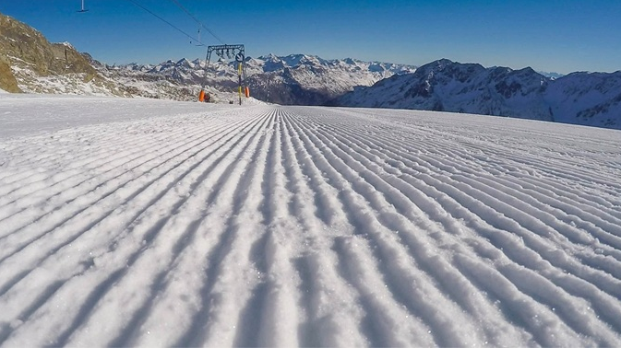
ECOskiers
by AlpineECOnomics

Slide 2
Introduction to Concept
Demonstration of App
Agenda
Business Model
Reflection

Slide 3
Introduction
Did you ever think about how sustainable your go-to ski resort is?
Future of winter sports
Ski resorts can act more or less sustainable
Choosing a “sustainable ski resort” for a more environmentally friendly impact
Our idea
Our vision
An easy structured app to find out which ski resort is sustainable
Simplify the booking process
Making sustainable skiing simple

Slide 4
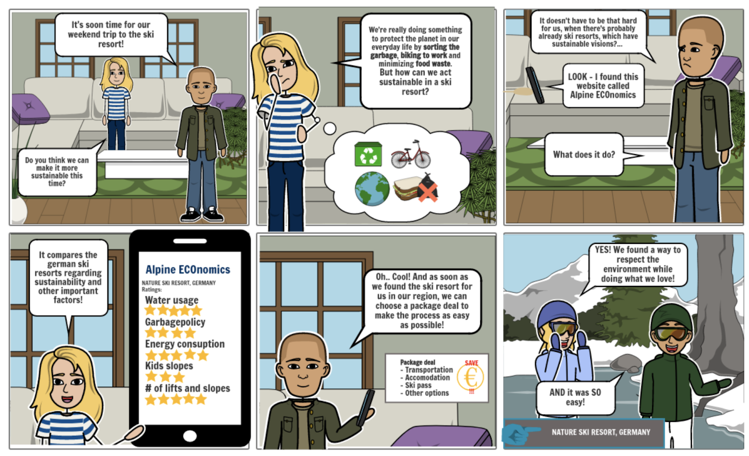

TO BE CONTINUED...

Slide 5
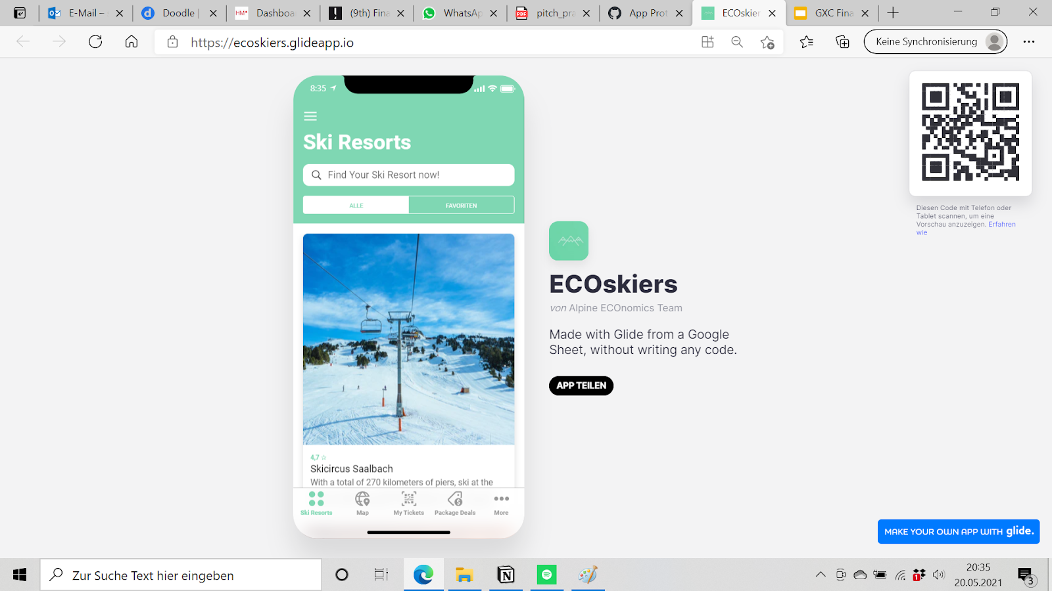

Let’s have a look and see how Mathias and Anna solve their problem…

Slide 6
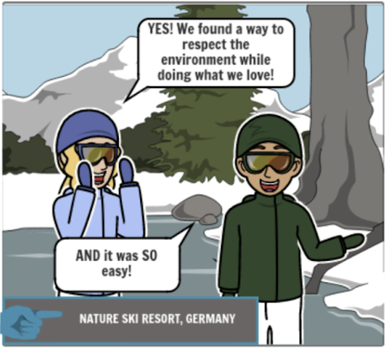
TO BE CONTINUED...

Slide 7
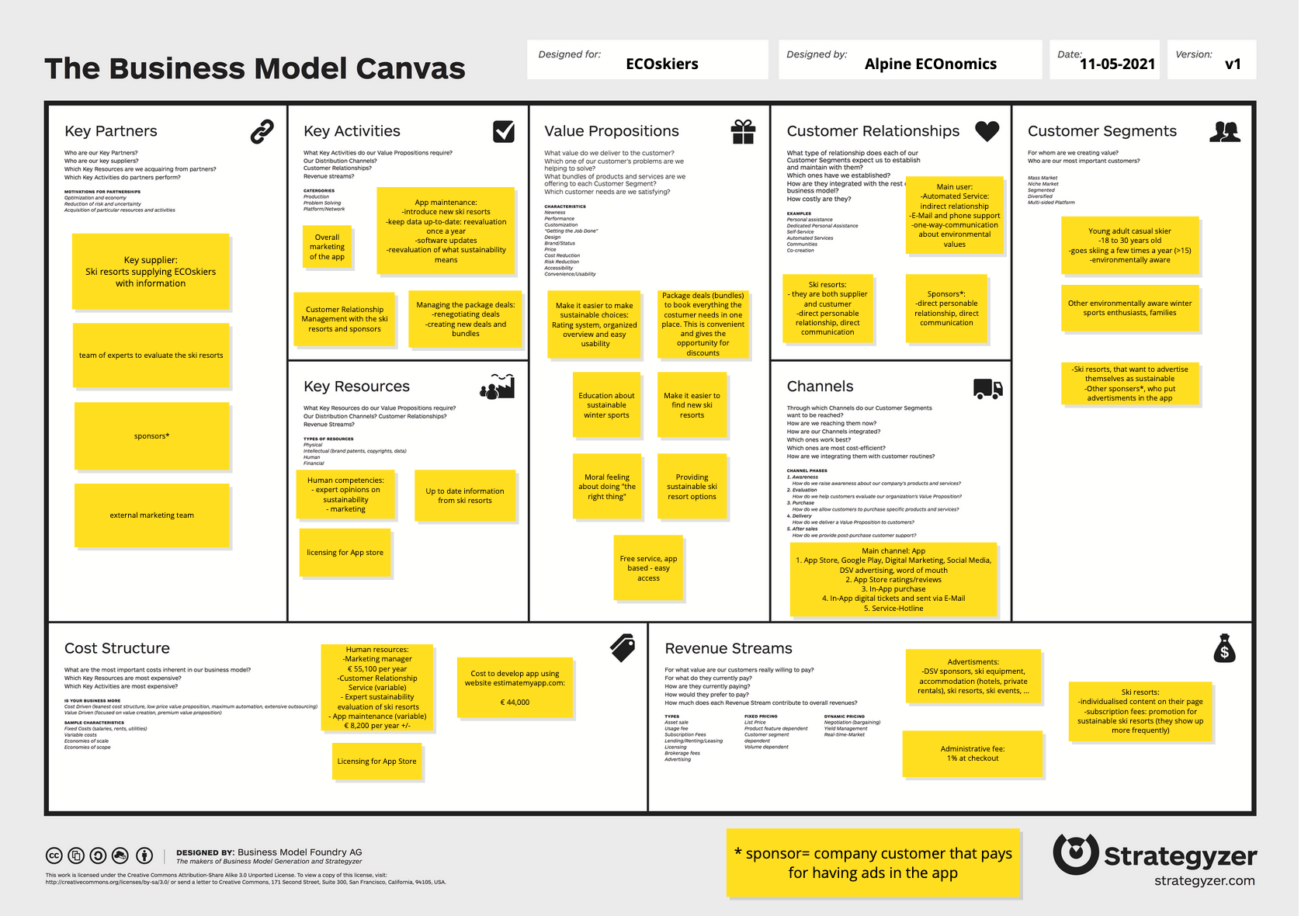
Business Model Canvas

Slide 8
Business Model Canvas
Value Proposition
Make it easier to make sustainable choices with savings and discounts
Educate people on making winter sports more sustainable
Main Customer Segments
Young adult casual skier (18-30 years old)
Environmentally aware sports enthusiasts
Ski resorts and sponsors

Slide 9

User Survey Feedback
Very unlikely
Very likely
Questionnaire answered by 77 people
68% were aged in our main target group
Most important takeaway:
75% of respondents said they would use app/service if it was available now
Proof of Concept
Not likely
Likely

Slide 10

Revenue Streams
3 streams of income:
In-app advertisements
Individualized content for ski resorts (pictures and introductory text)
Brokerage Fee

Slide 11
Starting Investment
44,000 EUR
Cost Structure
Source: estimatemyapp.com
Relatively cheap
Human competencies - outsourced expert sustainability evaluations of ski resorts
Marketing team - internal or outsourced
Customer Service and App Maintenance
Business is viable

Slide 12




Why is our challenge contribution valuable?
1: Users are picking the sustainable ski resorts
Ski Resorts
Challenge Giver
End User
Encouraged to improve facilities and policies
=
Building a sustainable future for winter sports
Improved image
Additional revenue source
Improve relationship with sponsors and resorts
No leaving the comfortzone or sacrificing convenience to be sustainable
+
Educated about sustainability
2: Ski resorts improving their facilities
3: Ski resorts are getting better ratings in ECOskiers

Slide 13
Teamwork
International students
Improving teamwork abilities
Sharing competences
Challenge
Educating ourselves about sustainability and winter sports
App prototyping was a great experience
Reflection
Virtual Course Format
Informative and organized meetings
Giving coaching sessions
Plenty of feedback from course professors

Slide 14
Thank you for your attention!

